Slide 2
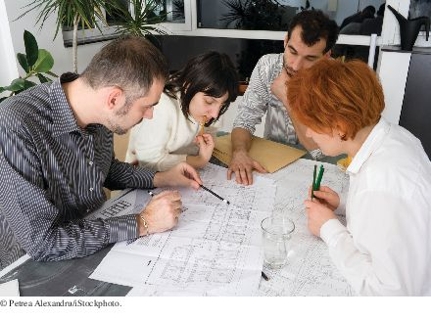
Chapter Goals
How to discover new classes and methods
How to use CRC cards for class discovery
How to identify inheritance, aggregation, and dependency relationships between classes
How to describe class relationships using UML class diagrams
How to apply object-oriented design techniques to building complex programs

Slide 3
Discovering Classes
When designing a program, you work from a requirements specification
The designer’s task is to discover structures that make it possible to implement the requirements
To discover classes, look for nouns in the problem description.
Find methods by looking for verbs in the task description.

Slide 4
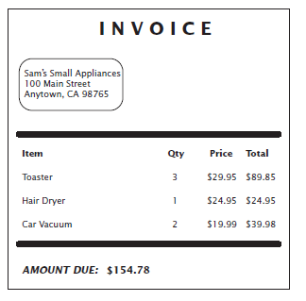
Example: Invoice
Figure 1 An Invoice

Slide 5
Example: Invoice
Classes that come to mind:
Invoice
LineItem
Customer
Good idea to keep a list of candidate classes.
Brainstorm: put all ideas for classes onto the list.
Concepts from the problem domain are good candidates for classes.
Not all classes can be discovered from the program requirements:
Most programs need tactical classes

Slide 6
The CRC Card Method
After you have a set of classes
Define the behavior (methods) of each class
Look for verbs in the task description
Match the verbs to the appropriate objects
The invoice program needs to compute the amount due
Which class is responsible for this method?
Invoice class

Slide 7
The CRC Card Method
To find the class responsibilities, use the CRC card method.
A CRC card describes a class, its responsibilities, and its collaborating classes.
CRC - stands for “classes”, “responsibilities”, “collaborators”
Use an index card for each class.
Pick the class that should be responsible for each method (verb).
Write the responsibility onto the class card.
Indicate what other classes are needed to fulfill responsibility (collaborators).

Slide 8
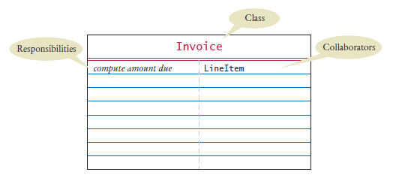
The CRC Card Method
Figure 2 A CRC Card

Slide 9
Relationships Between Classes
The most common types of relationships:
Dependency
Aggregation
Inheritance

Slide 10
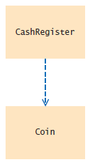
Dependency
A class depends on another class if it uses objects of that class. The “knows about” relationship.
Example: CashRegister depends on Coin
Figure 3 Dependency Relationship Between the CashRegister and Coin Classes

Slide 11
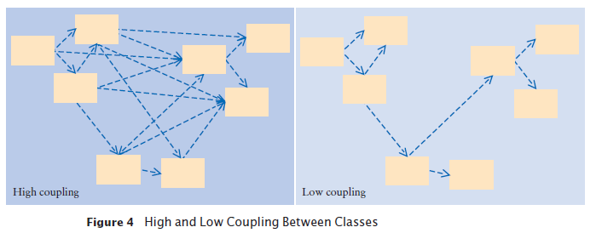
Dependency
It is a good practice to minimize the coupling (i.e., dependency) between classes.
When a class changes, coupled classes may also need updating.

Slide 12
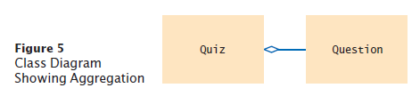
Aggregation
A class aggregates another if its objects contain objects of the other class.
Has-a relationship
Example: a Quiz class aggregates a Question class.
The UML for aggregation:
Aggregation is a stronger form of dependency.
Use aggregation to remember another object between method calls.

Slide 13
Aggregation
Use an instance variable
public class Quiz
{
private ArrayList<Question> questions;
. . .
}
A class may use the Scanner class without ever declaring an instance variable of class Scanner. This is dependency NOT aggregation

Slide 14

Aggregation
A car has a motor and tires. In object-oriented design, this “has-a” relationship is called aggregation.

Slide 15
Inheritance
Inheritance is a relationship between a more general class (the superclass) and a more specialized class (the subclass).
The “is-a” relationship.
Example: Every truck is a vehicle.
Inheritance is sometimes inappropriately used when the has-a relationship would be more appropriate.
Should the class Tire be a subclass of a class Circle? No
A tire has a circle as its boundary
Use aggregation
public class Tire
{
private String rating;
private Circle boundary;
. . .
}

Slide 16
Inheritance
Every car is a vehicle. (Inheritance)
Every car has a tire (or four). (Aggregation)
class Car extends Vehicle
{
private Tire[] tires;
. . .
}

Slide 17
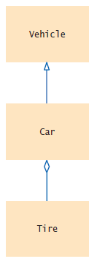
Inheritance
Aggregation denotes that objects of one class contain references to objects of another class.
Figure 6 UML Notation for Inheritance and Aggregation

Slide 18
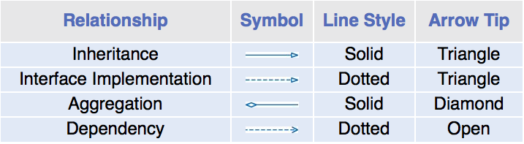
UML Relationship Symbols

Slide 19
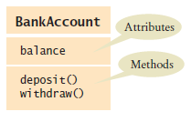
Attributes and Methods in UML Diagrams

Slide 20
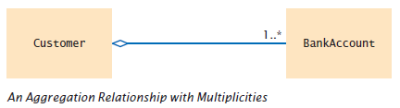
Multiplicities
any number (zero or more): *
one or more: 1..*
zero or one: 0..1
exactly one: 1

Slide 21
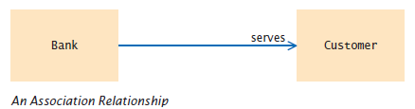
Aggregation and Association, and Composition
Association: More general relationship between classes.
Use early in the design phase.
A class is associated with another if you can navigate from objects of one class to objects of the other.
Given a Bank object, you can navigate to Customer objects.

Slide 22
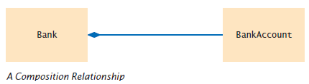
Aggregation and Association, and Composition
Composition: one of the classes can not exist without the other.

Slide 23
Sample Application: Printing an Invoice
Five-part program development process:
Gather requirements
Use CRC cards to find classes, responsibilities, and collaborators
Use UML diagrams to record class relationships
Use javadoc to document method behavior
Implement/code your program

Slide 24
Application: Printing an Invoice - Requirements
Start the development process by gathering and documenting program requirements.
Task: Print out an invoice
Invoice: Describes the charges for a set of products in certain quantities.
Omit complexities
Dates, taxes, and invoice and customer numbers
Print invoice
Billing address, all line items, amount due
Line item
Description, unit price, quantity ordered, total price
For simplicity, do not provide a user interface.
Test program: Adds line items to the invoice and then prints it.

Slide 25
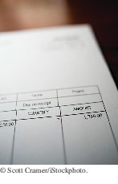
Application: Printing an Invoice
Sample Invoice
I N V O I C E
Sam's Small Appliances
100 Main Street
Anytown, CA 98765
Description Price Qty Total
Toaster 29.95 3 89.85
Hair dryer 24.95 1 24.95
Car vacuum 19.99 2 39.98
AMOUNT DUE: $154.78
An invoice lists the charges for each item and the amount due.

Slide 26
Application: Printing an Invoice – CRC Cards
Use CRC cards to find classes, responsibilities, and collaborators.
Discover classes
Nouns are possible classes:
Invoice
Address
LineItem
Product
Description
Price
Quantity
Total
Amount
Due

Slide 27
Application: Printing an Invoice – CRC Cards
Analyze classes:
Invoice
Address
LineItem // Records the product and the quantity
Product
Description // Field of the Product class
Price // Field of the Product class
Quantity // Not an attribute of a Product
Total // Computed - not stored anywhere
Amount Due // Computed - not stored anywhere
Classes after a process of elimination:
Invoice
Address
LineItem
Product

Slide 28

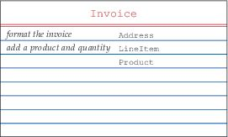
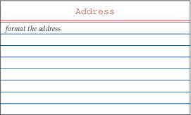
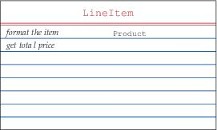
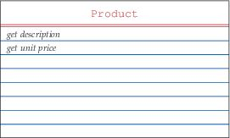
CRC Cards for Printing Invoice
Add collaborators to Invoice card:

Slide 29
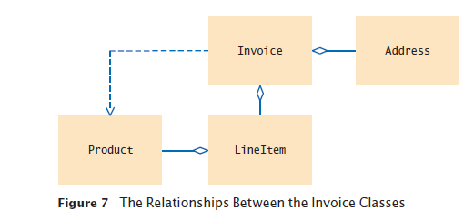
Application: Printing an Invoice – UML Diagrams

Slide 30
Printing an Invoice — Method Documentation
Use javadoc comments (with the method bodies left blank) to record the behavior of the classes.
Write a Java source file for each class:
Write the method comments for those methods that you have discovered,
Leave the body of the methods blank
Run javadoc to obtain formatted version of documentation in HTML format.
Advantages:
Share HTML documentation with other team members
Format is immediately useful: Java source files
Supply the comments of the key methods

Slide 31
Method Documentation Javadoc Tags for the Invoice Class
/**
Describes an invoice for a set of purchased products.
*/
public class Invoice
{
/**
Adds a charge for a product to this invoice.
@param aProduct the product that the customer ordered
@param quantity the quantity of the product
*/
public void add(Product aProduct, int quantity)
{
}
/**
Formats the invoice.
@return the formatted invoice
*/
public String format()
{
}
}

Slide 32
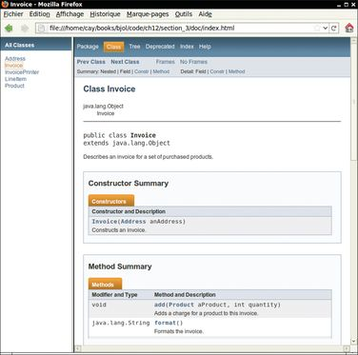
The Class Documentation in the HTML Format
Figure 8 Class Documentation in HTML Format

Slide 33
Implementation
Questions to Answer after viewing the Invoice Printer Project Folder in Netbeans (see attached):
What class aggregates other classes?
How many Billing Addresses are in each Invoice?
How many LineItems are in each Invoice?
How many Products are stored in each LineItem?
Which class is responsible for computing the amount due? What are its collaborators for this task?
Why do the format methods return String objects instead of directly printing to System.out?

